Slide 1
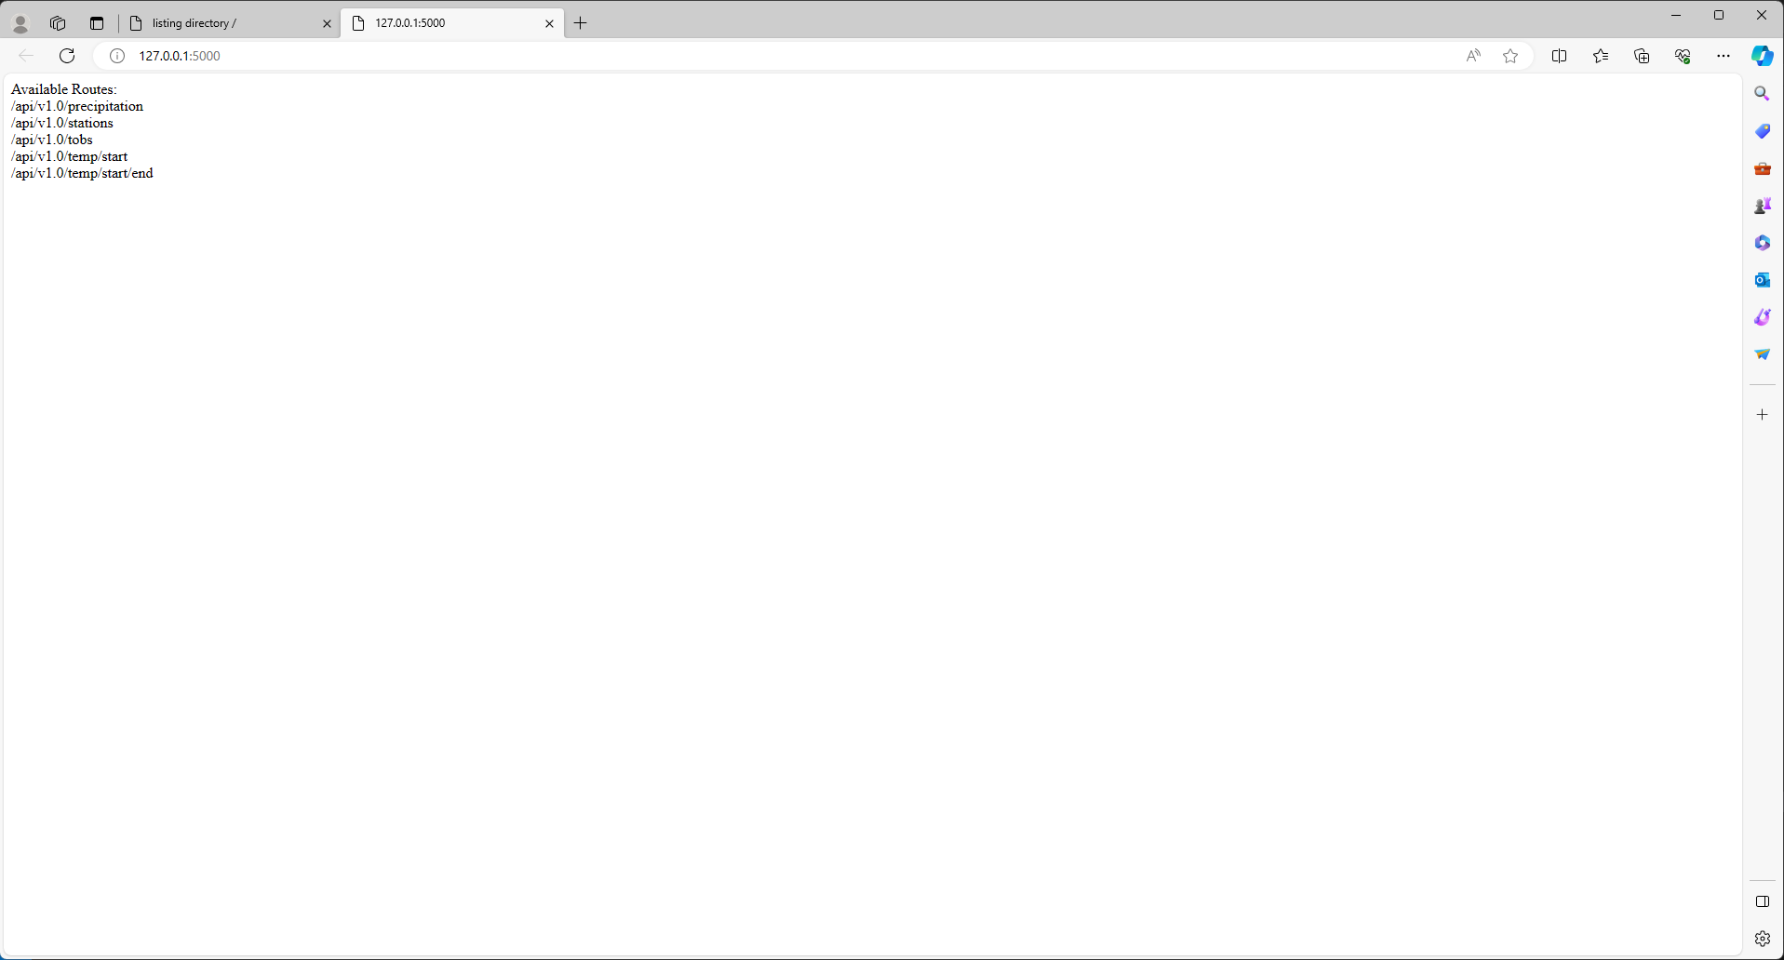
M10 SQL Alchemy Output – Initial Screen – Available Routes

Slide 2
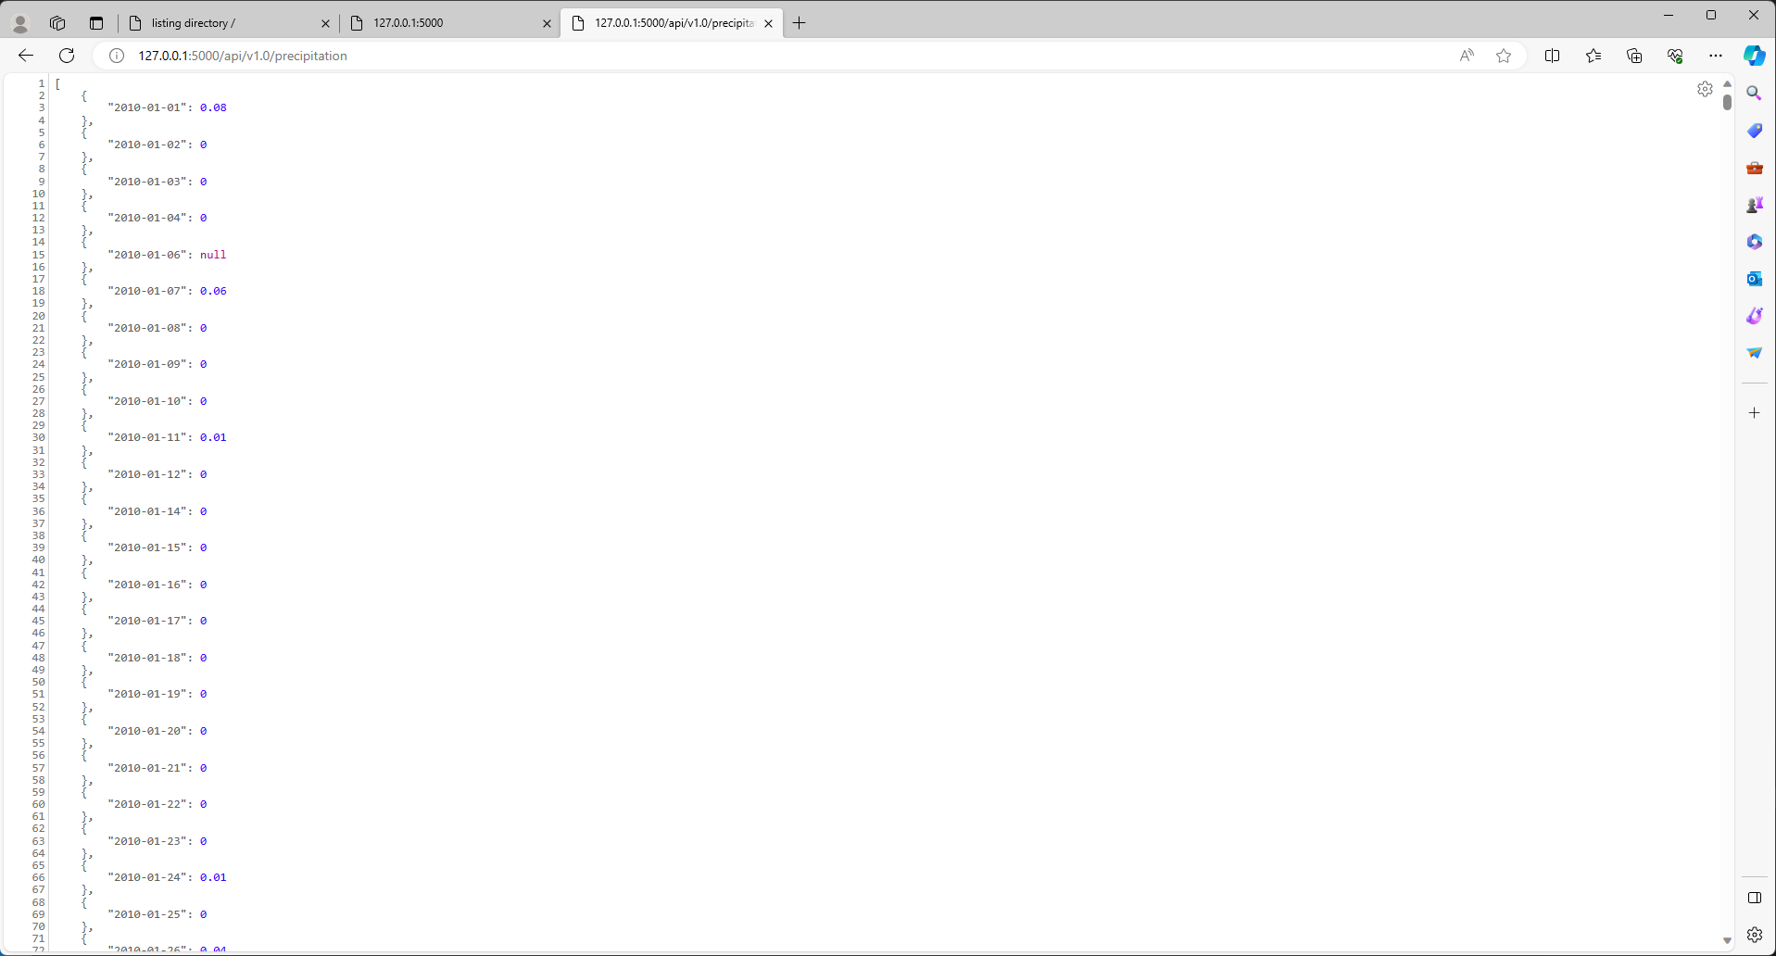
M10 SQL Alchemy Output – Precipitation

Slide 3
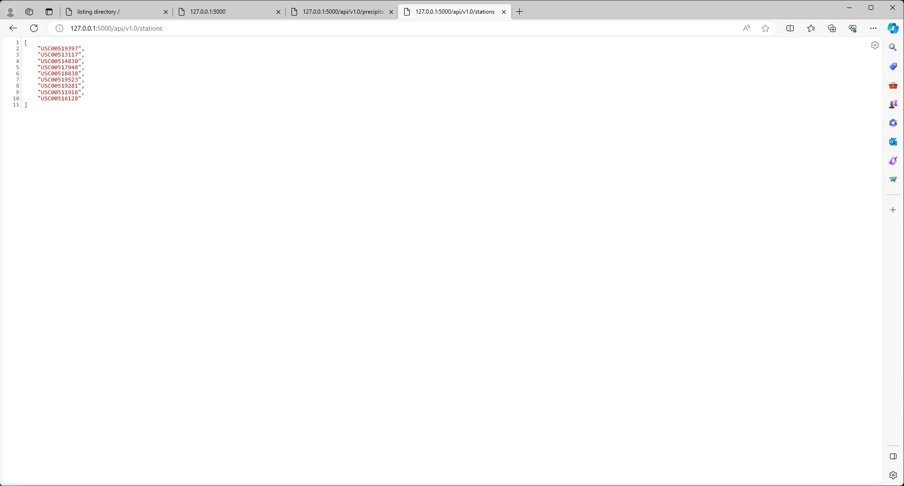
M10 SQL Alchemy Output – Stations

Slide 4
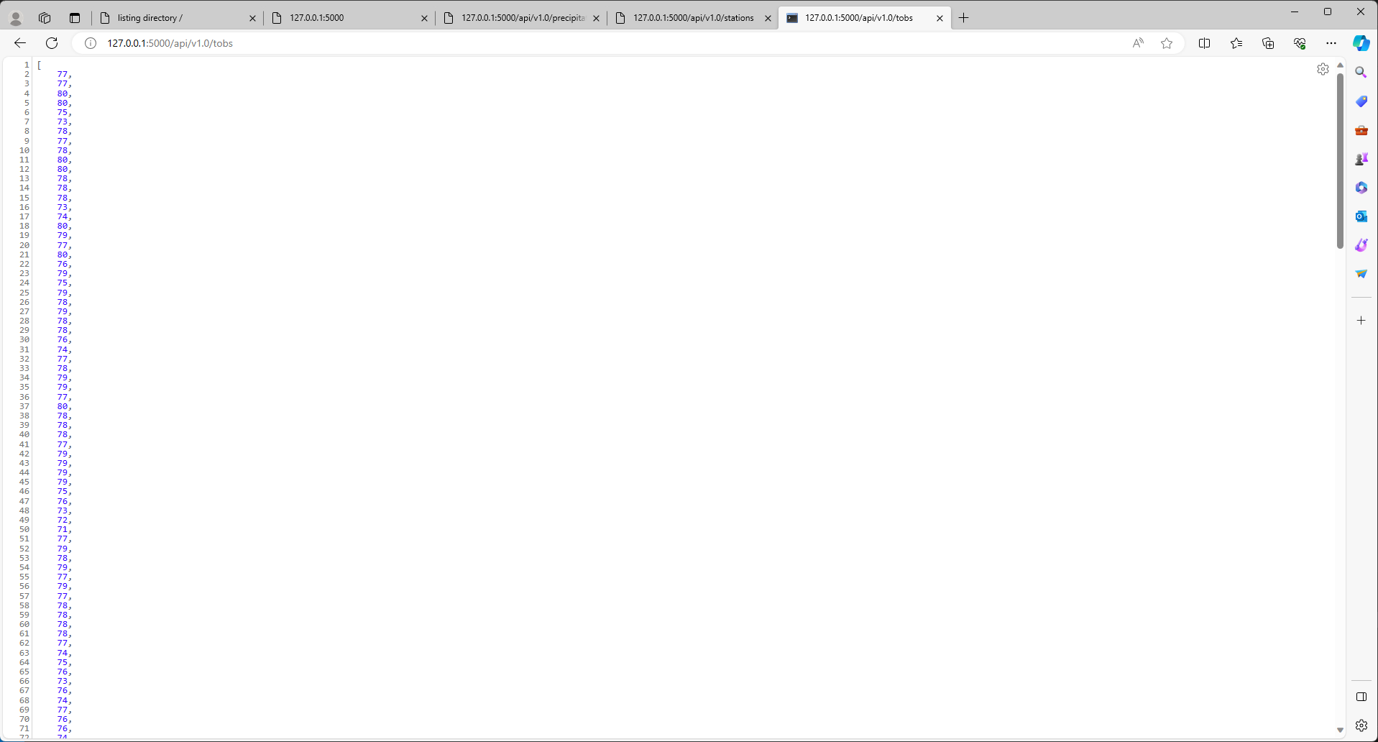
M10 SQL Alchemy Output – Temperature Observations

Slide 5
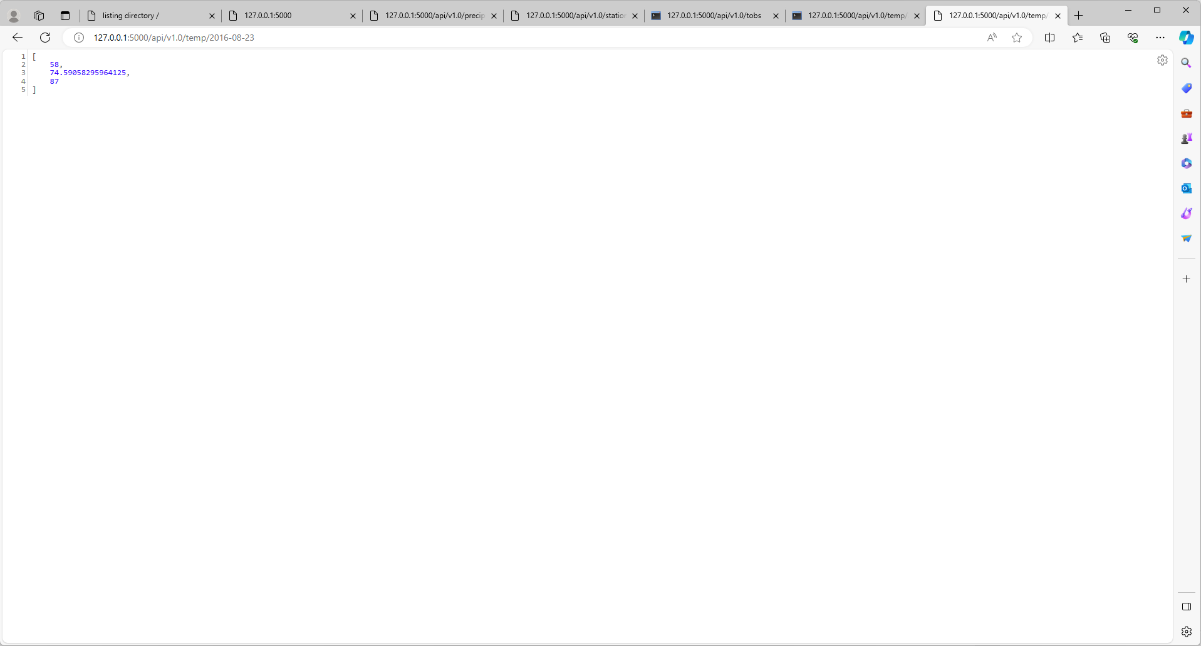
M10 SQL Alchemy Output – Temperature Start – Minimum, Average, Maximum

Slide 6
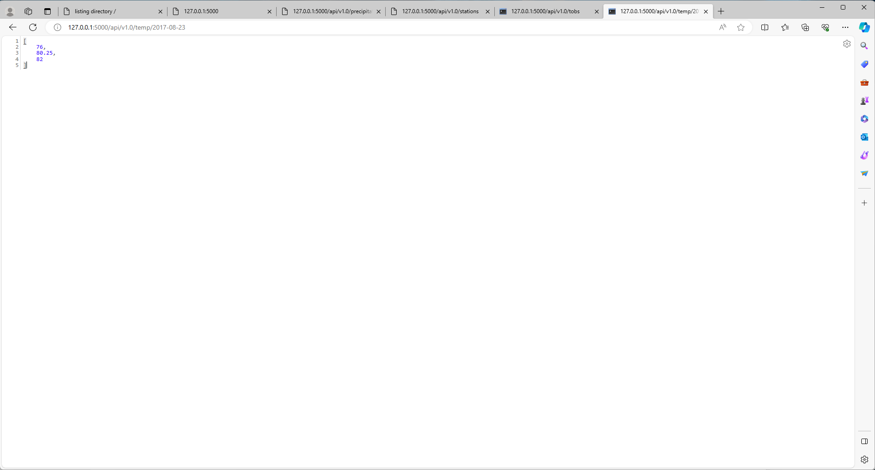
M10 SQL Alchemy Output – Temperature End – Minimum, Average, Maximum

Slide 7
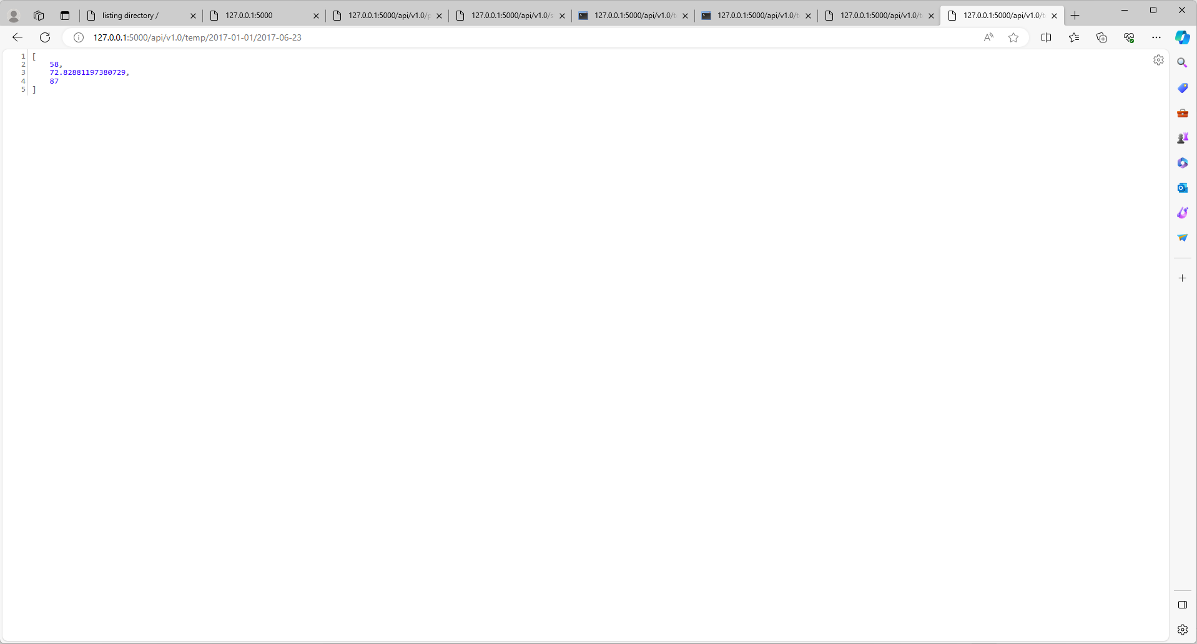
M10 SQL Alchemy Output – Temperature Start and End Date – Minimum, Average, Maximum

